Slide 1


Slide 2

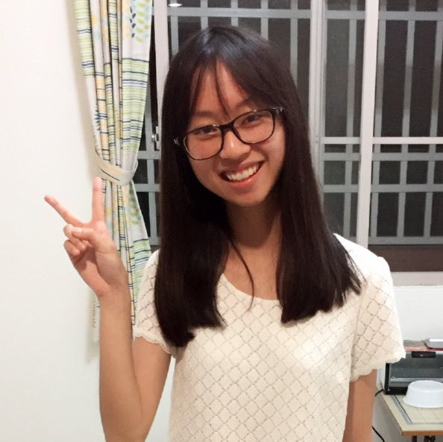

About Our Team
About Our Team
Why…
Company…
Business…
Policy
Economic...
Social...
Product...
Ke, Yi-Ting
柯宜婷
Chen, Kuan-Yu
陳冠羽
Hung, Yung-Chuan
洪泳銓

Slide 3

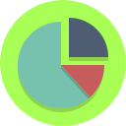


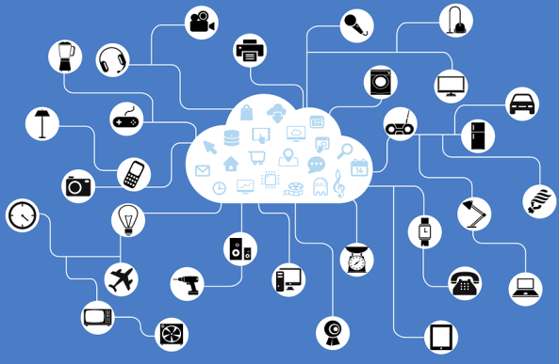




Why NextDrive?
About …
Why NextDrive?
Company…
Business…
Policy
Economic...
Social...
Product...
Internet of Things(IoT) is the world trend

Slide 4
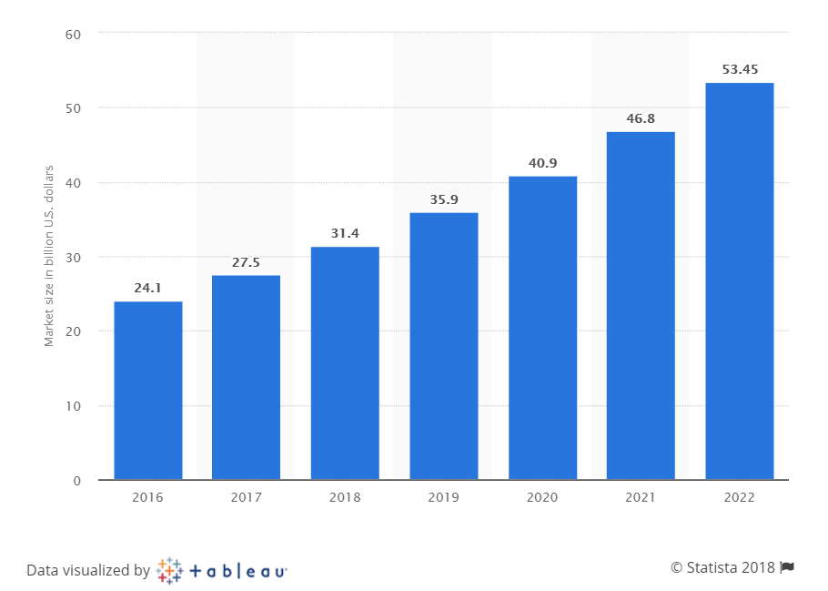
Why NextDrive?
About …
Why NextDrive?
Company…
Business…
Policy
Economic...
Social...
Product...
Forecast market size of the global smart home market from 2016 to 2022
Internet of Things(IoT) is the world trend
Ref: https://www.statista.com/statistics/682204/global-smart-home-market-size//

Slide 5



Company Background
About…
Why…
Company Backgrou…
Business…
Policy
Economic...
Social...
Product...
Company Background
Capital：
NT$ 25 million
(about US$ 850 thousand)
40 staff members
Founded in 2014

Slide 6
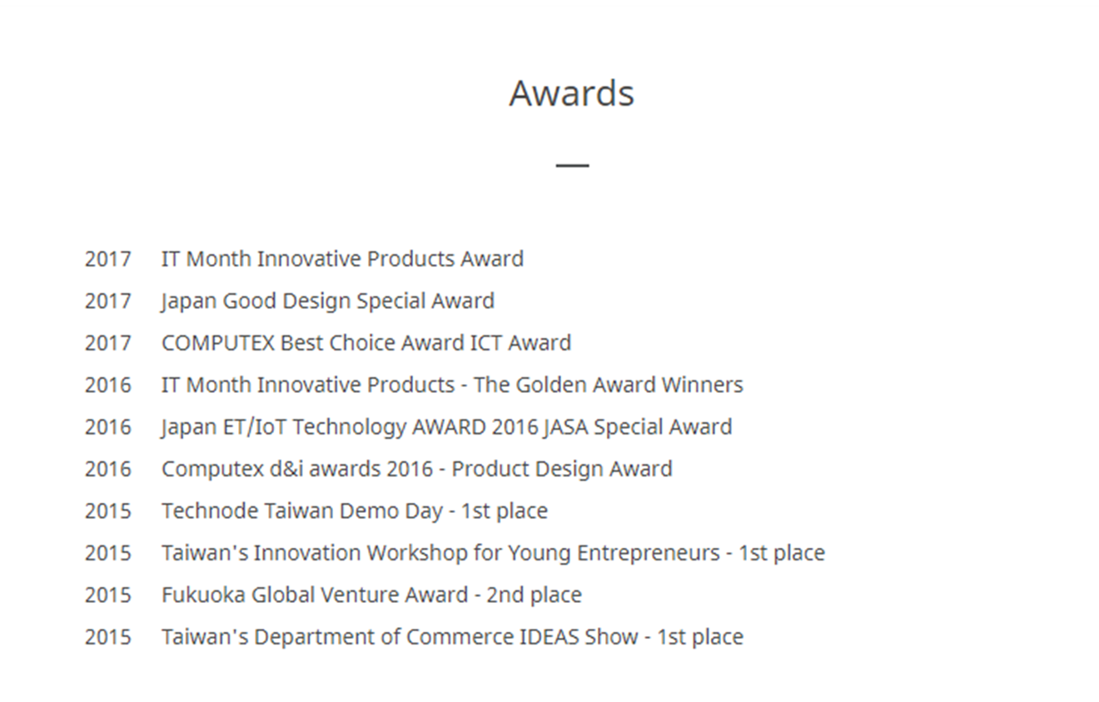
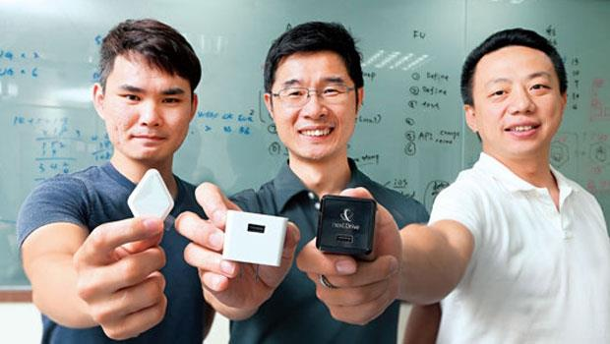
Company Background
About…
Why…
Company Backgrou…
Business…
Policy
Economic...
Social...
Product...
Company Background
Cofounders：
Chen, Chong-Guang (陳重光)、
Yan, Zhe-Yuan (顏哲淵)、
Chen, Liang-Xin (陳良信)

Slide 7
Business Model—Framework
About…
Why…
Company…
Business Model
Policy
Economic...
Social...
Product...
[Ref.： J. Ju, M. Kim, J. Ahn, Prototyping Business Models for IoT Service(2016)]
Business Model
Infrastructure
Key partner
Key resources
Key activities
Customer
Customer segments
Channel
Financials
Cost structure
Revenue structure
Value propositions

Slide 8

About…
Why…
Company…
Business Model
Policy
Economic...
Social...
Product...
Business Model—Infrastructure
Key Activities
Video retrieved from ”NextDrive Plug Home Security-NextDrive Plug & Pixi"
https://youtu.be/owvCj3q9umg?t=33

Slide 9
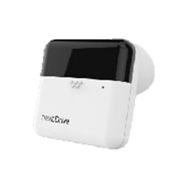
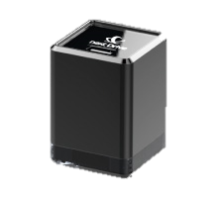
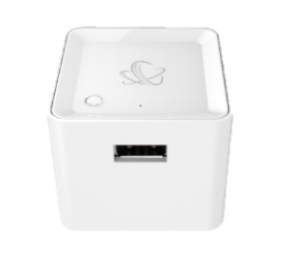
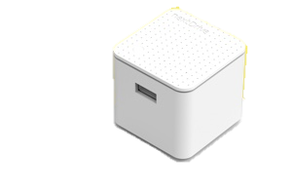
Product Evolution
About…
Why…
Company…
Business Model
Policy
Economic...
Social...
Product...
Business Model—Infrastructure
First
Second
Third
Cube J
NextDrive Plug
Cube

Slide 10

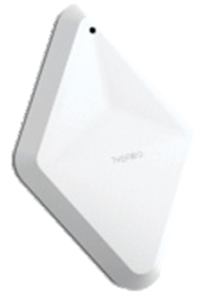
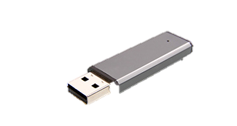
Product Variety
About…
Why…
Company…
Business Model
Policy
Economic...
Social...
Product...
Business Model—Infrastructure
NextDrive Cam S
Thermo Pixi
Motion Pixi
USB

Slide 11


Business Model—Infrastructure
About…
Why…
Company…
Business Model
Policy
Economic...
Social...
Product...
Developed Cube J that meets Japanese wireless communication specifications in cooperation with Kyoto University in Japan.
Key Partner
Key Resources
The staff composition of the company is mainly based on R&D personnel.

Slide 12



Business Model—Value Proposition
About…
Why…
Company…
Business Model
Policy
Economic...
Social...
Product...
Energy management
Home security

Slide 13

Business Model—Customer
About…
Why…
Company…
Business Model
Policy
Economic...
Social...
Product...
Customer Segments
Segment
Target
Family type
Single
Dink
Small family
Big family
Solitary Elderly
Single
Small family
Solitary Elderly

Slide 14


About…
Why…
Company…
Business Model
Policy
Economic...
Social...
Product...
Business Model—Customer
Now
Channel
Future
Sell its products on NextDrive’s online store
Cooperation with electronic business platform
Expand exports to other countries
Cooperation with the real estate industry

Slide 15
Business Model—Financials
About…
Why…
Company…
Business Model
Policy
Economic...
Social...
Product...
15%Profit
Price: NT$ 1990
Cost: NT$ 1990/1.15= NT$ 1730

Slide 16
Government Policy
About…
Why…
Company…
Business…
Policy
Economic...
Social...
Product...
Refer to 【The company applies investment deduction methods
for research and development expenditures】
(公司研究發展支出適用投資抵減辦法)
Assistance
Tax reduction
Funding
Obstacles
Unclear qualification
Time consuming

Slide 17
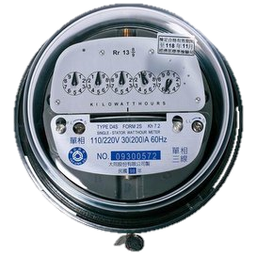
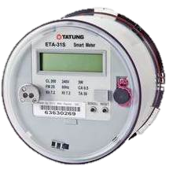
Economic Impacts
About…
Why…
Company…
Business…
Policy
Economic Impacts
Social...
Product...
Mechanical meter
Smart meter

Slide 18
Social Impacts
About…
Why…
Company…
Business…
Policy
Economic...
Social Impacts
Product...
Home Security Monitoring
Positive
Negative
Home
security
Information
security

Slide 19
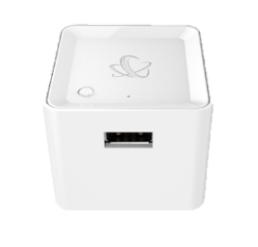

Product Recommendation
About…
Why…
Company…
Business…
Policy
Economic...
Social...
Product Recomme…
IoT Gateway
NEW!
Wi-Fi

Slide 20


Product Recommendation
About…
Why…
Company…
Business…
Policy
Economic...
Social...
Product Recomme…
Reduce the number of devices
Setting simplification

Slide 21
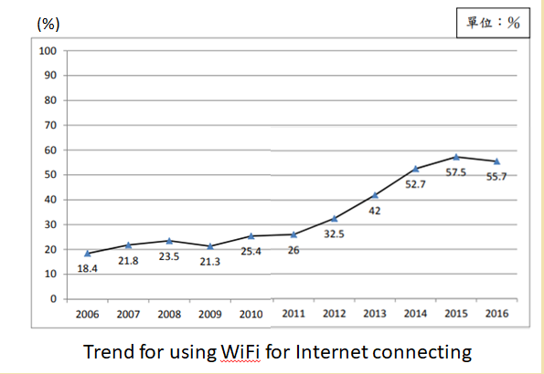
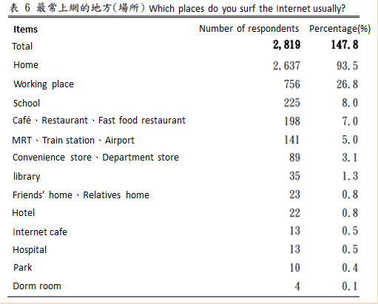
Product Recommendation
About…
Why…
Company…
Business…
Policy
Economic...
Social...
Product Recomme…
[Ref.：2016 Taiwan Internet Usage Survey Report]
Which place do you surf the Internet usually?

Slide 22
References
NextDrive’s Official website
https://www.nextdrive.io/tw/
Intel IoT -- What Does The Internet of Things Mean?
https://youtu.be/Q3ur8wzzhBU
J. Ju, M. Kim, J. Ahn, Prototyping Business Models for IoT Service, Procedia Computer Science, Volume 91, 2016, Pages 882-890
https://www.sciencedirect.com/science/article/pii/S1877050916312911
公司研究發展支出適用投資抵減辦法
http://law.moj.gov.tw/LawClass/LawContent.aspx?PCODE=J0030113
『 2016 Taiwan Internet Usage Survey Report 』
https://www.twnic.net.tw/download/200307/20160922e.pdf

Slide 23


